Slide 1
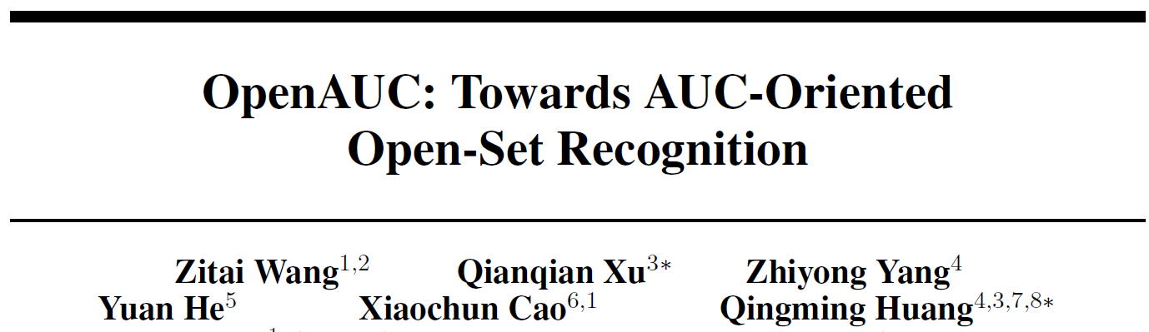
Published in NeurIPS 2022
Mingle Xu
2023 May 23

Slide 2
Content and highlights
Background of evaluation metric of OSR.
A new metric: OpenAUC.
Metric → loss function.
Term project recommendations.
This paper
Has elegant mathematical equations along with fabulous intuitions → chance to improve mathematical feeling and know common usage of notations.
Has nice analyzing and summarization, a good example to do research. (The first author published several high-level papers using the same motivation.)

Slide 3
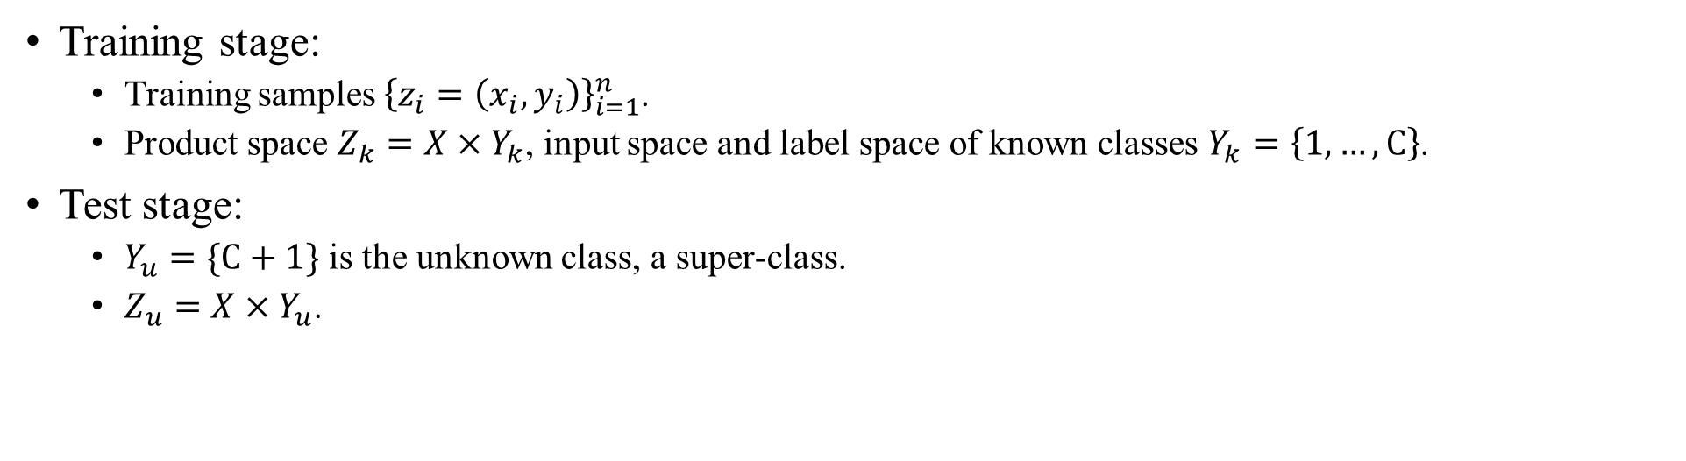
Notations
Training stage:
Training samples ${\left\{z_{i}=\left(x_{i},y_{i}\right)\right\}}_{i=1}^{n}$.
Product space $Z_{k}=X×Y_{k}$, input space and label space of known classes $Y_{k}=\left\{1,…,C\right\}$.
Test stage:
$Y_{u}=\{C+1\}$ is the unknown class, a super-class.
$Z_{u}=X×Y_{u}$.

Slide 4
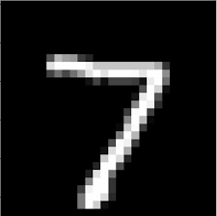
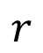
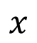
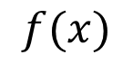
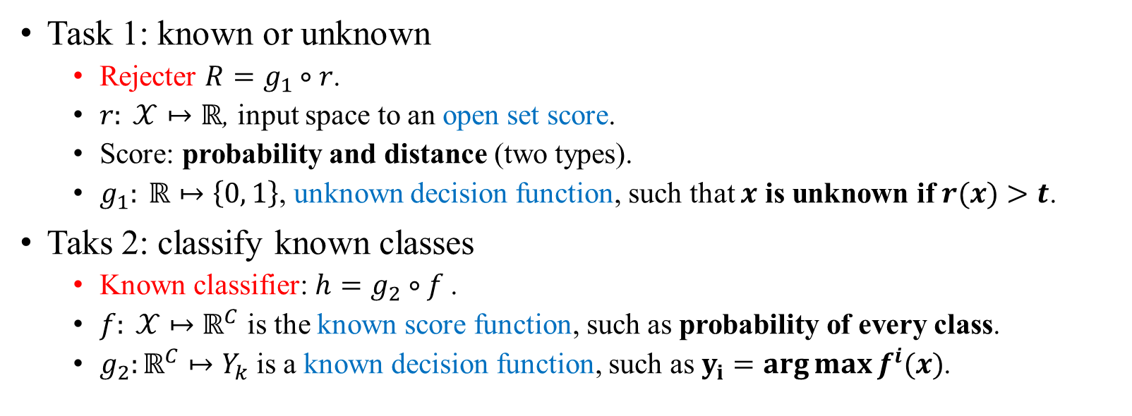
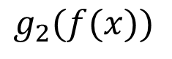
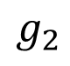
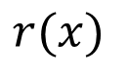
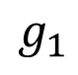
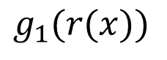
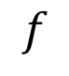
Basic knowledge
$$g_{1}$$
$$r$$
$$r(x)$$
$$g_{1}(r(x))$$
Known or unknown?
$$x$$
$$g_{2}$$
$$f$$
$$f(x)$$
$$g_{2}(f(x))$$
Which known class?
Task 1: known or unknown
Rejecter $R=g_{1}∘r$.
$r: 𝒳↦ℝ$, input space to an open set score.
Score: probability and distance (two types).
$g_{1}: ℝ↦\left\{0, 1\right\}$, unknown decision function, such that $x$ is unknown if$r(x)>t$.
Taks 2: classify known classes
Known classifier: $h=g_{2}∘f$.
$f: 𝒳↦$ $ℝ^{C}$ is the known score function, such as probability of every class.
$g_{2}:ℝ^{C}↦Y_{k}$is a known decision function, such as $y_{i}=arg{\max{f^{i}(x)}}$.

Slide 5
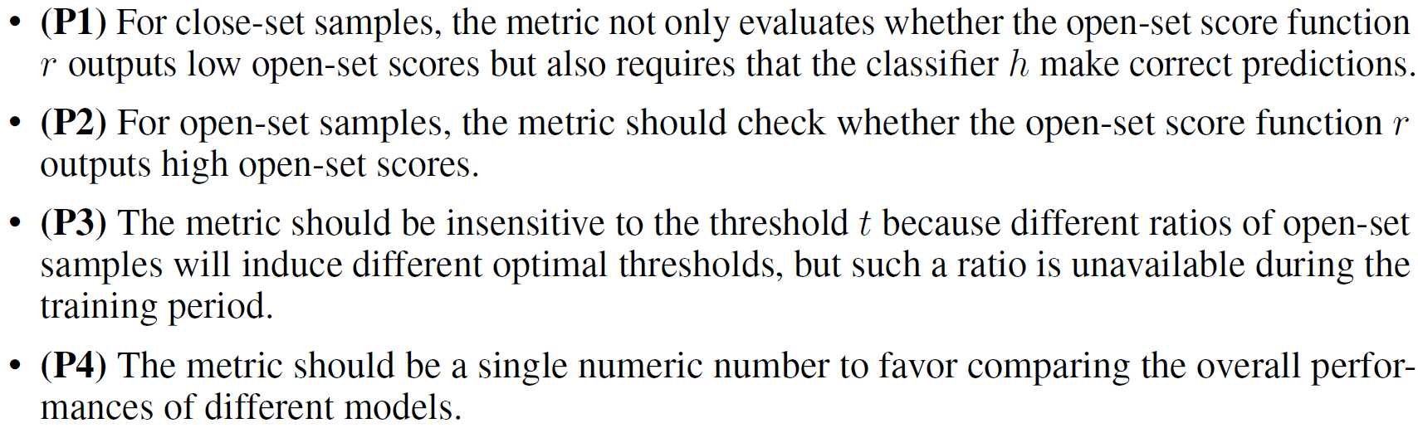
Desired characteristics of OSR evaluation metric
Why? Evaluate models and potential loss functions to train models.

Slide 6
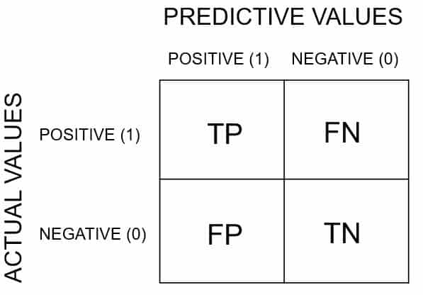
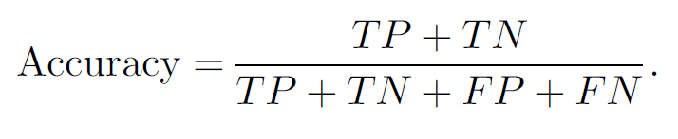
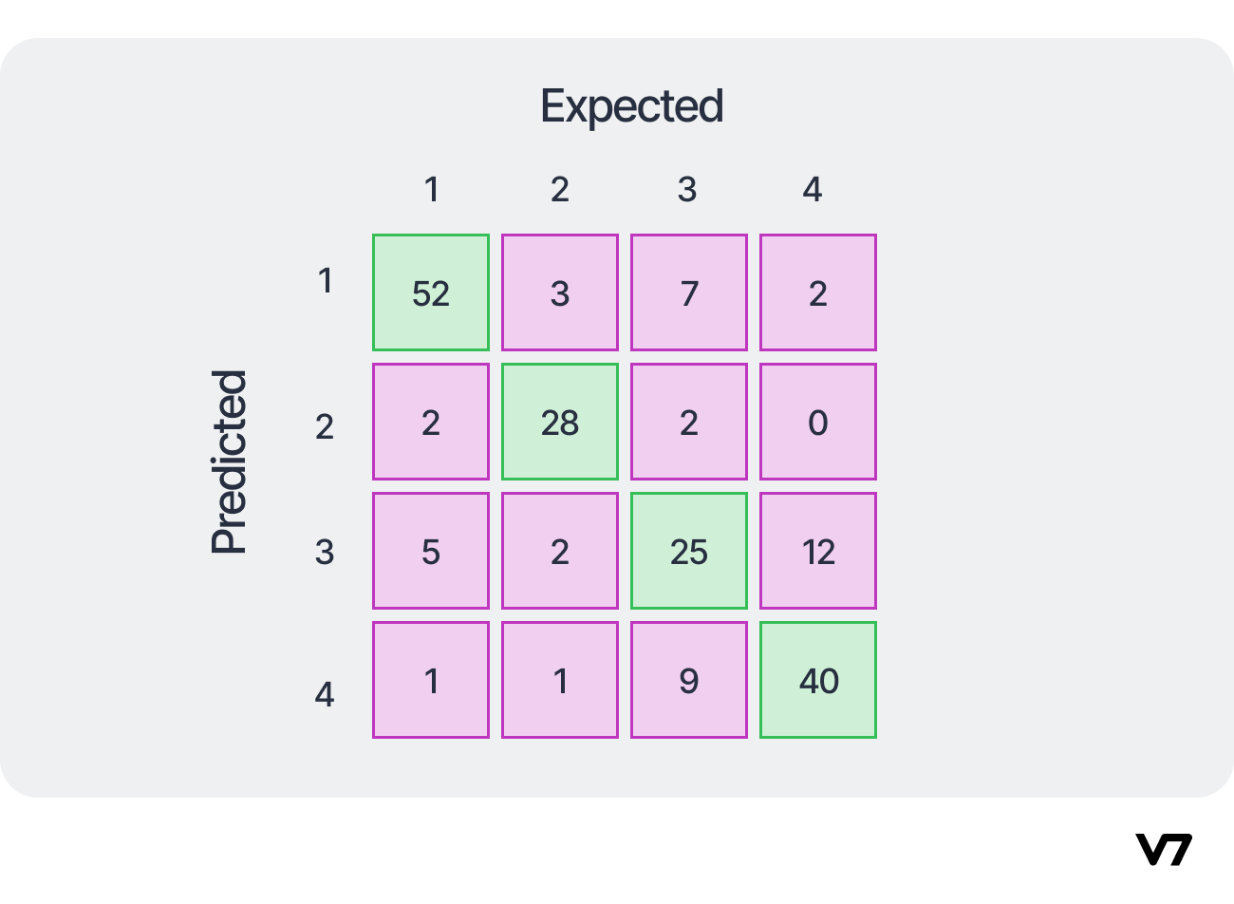
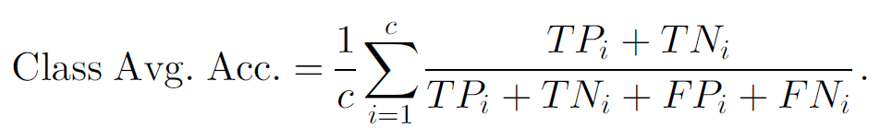
Background: accuracy and its averaged version
Accuracy, confusion matrix (binary), multi-class.
What is the positive?
Class average accuracy for unbalanced testing samples.
Toward Open Set Recognition, 2013 PAMI.

Slide 7
OSR accuracy
Take all unknown images as one super-class.
Maybe sensitive to the number of unknown images.
An example.
Unknown
Unknown
Toward Open Set Recognition, 2013 PAMI.
Notes:
False cls for known = cls known to unknown and unknown to known.

Slide 8
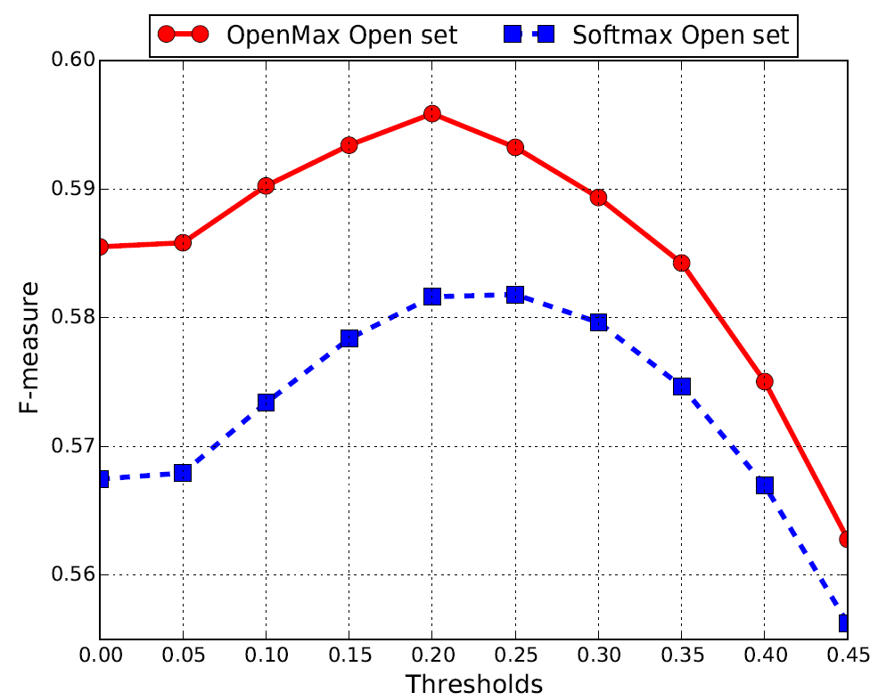
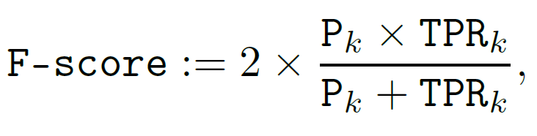
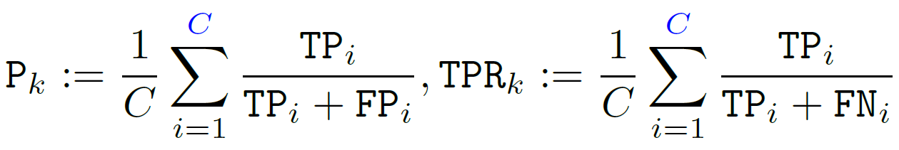
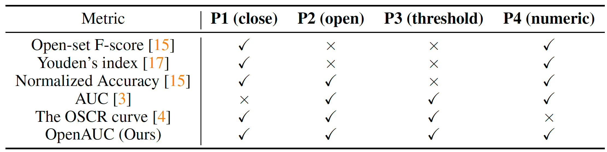
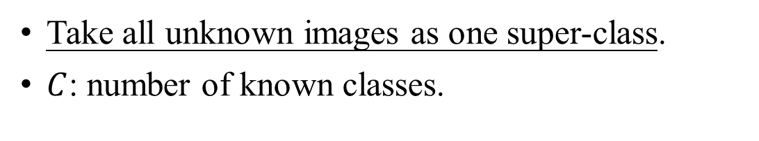
OSR F-score
Take all unknown images as one super-class.
$C$: number of known classes.

Slide 9
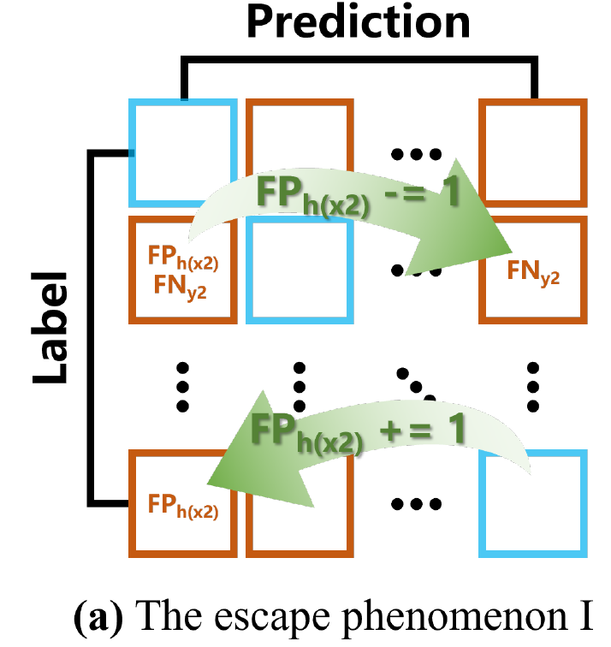
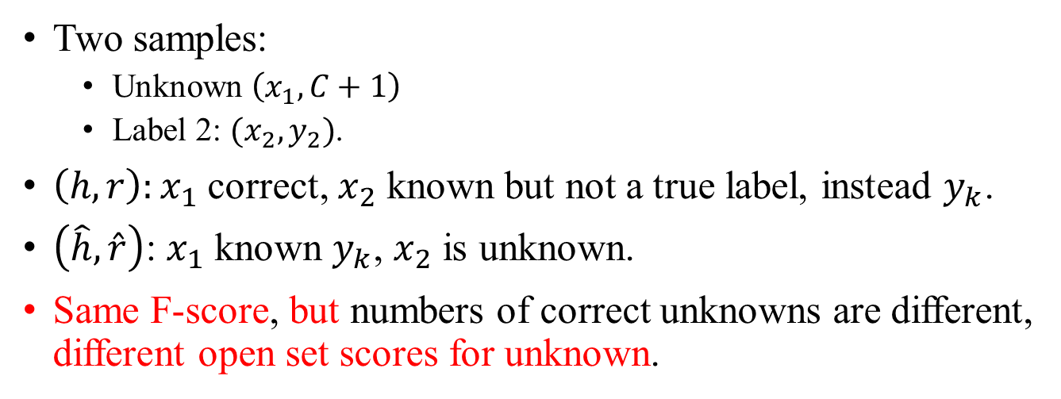
Issue in F-score: metric inconsistent
Two samples:
Unknown $\left(x_{1},C+1\right)$
Label 2: $(x_{2},y_{2})$.
$\left(h,r\right):x_{1}$ correct, $x_{2}$ known but not a true label, instead $y_{k}$.
$\left(\hat{h},\hat{r}\right)$: $x_{1}$ known $y_{k}$, $x_{2}$ is unknown.
Same F-score, but numbers of correct unknowns are different, different open set scores for unknown.

Slide 10
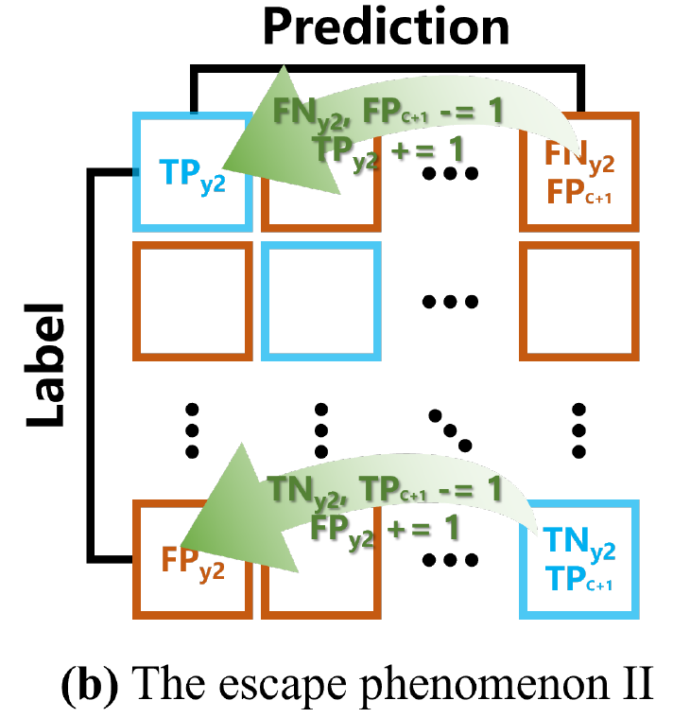
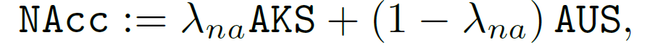
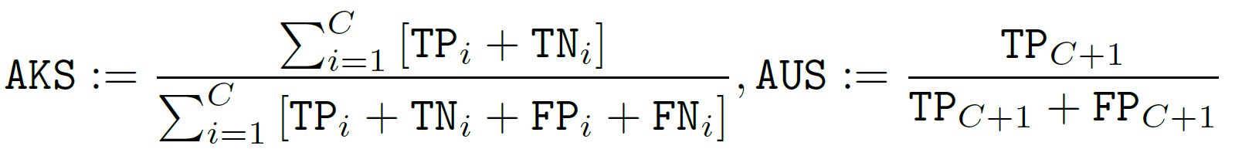
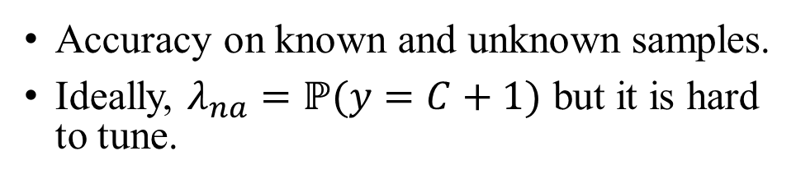
NAcc, normalized accuracy
Accuracy on known and unknown samples.
Ideally, $λ_{na}=ℙ(y=C+1)$ but it is hard to tune.
A lower threshold results in the same metric value.

Slide 11
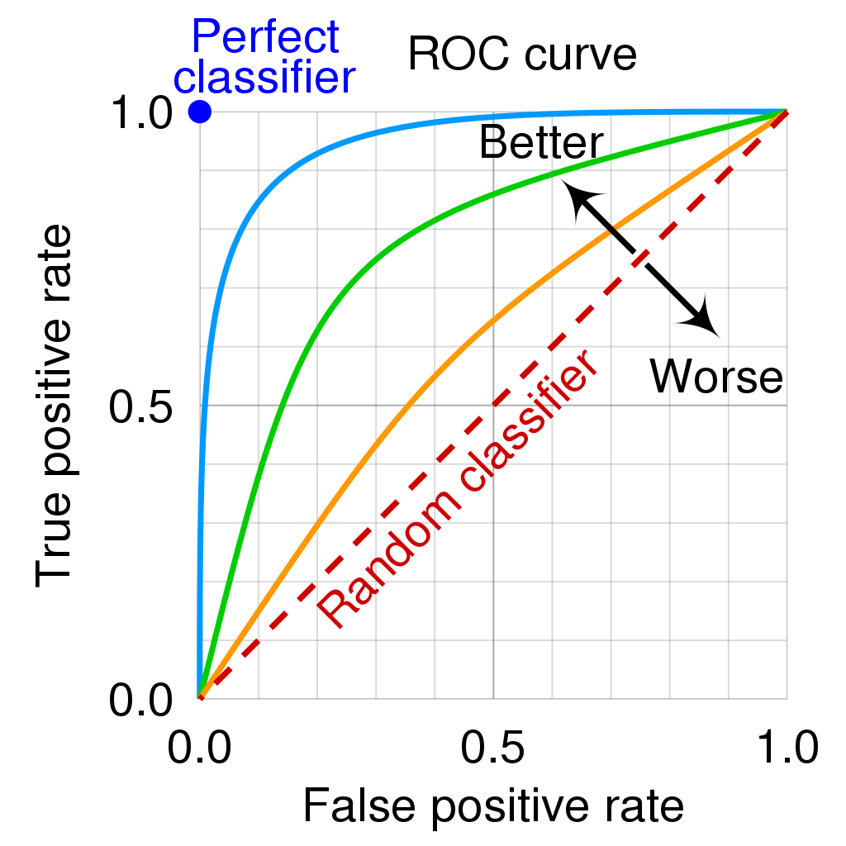
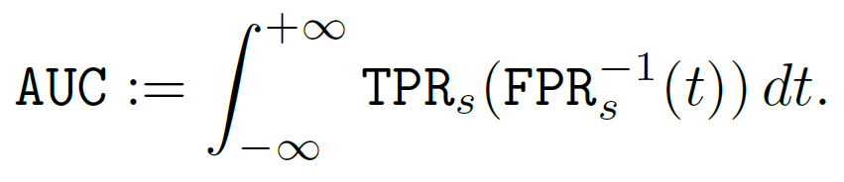
AUC or AUROC
Cast OSR as a binary classification: known and unknown. The Known is a super-class.
Area under the ROC Curve.
Insensitive to thresholds.
But can not check if known is classified correctly.

Slide 12
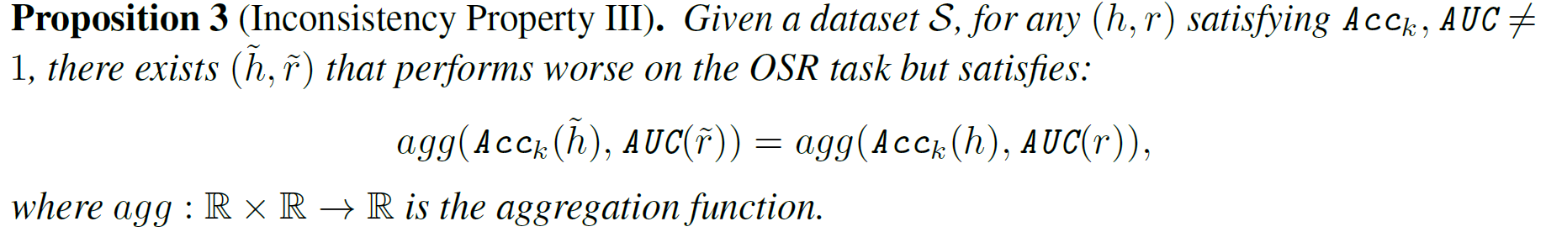
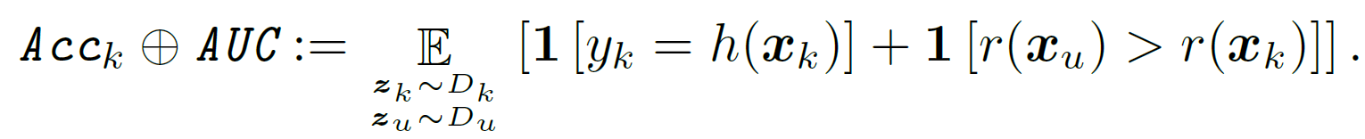
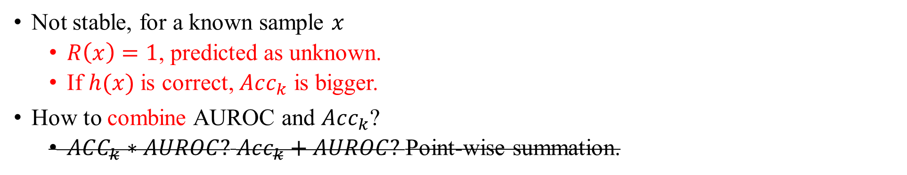
Use AUROC and $Acc_{k}$ (known classification accuracy)
Not stable, for a known sample $x$
$R\left(x\right)=1$, predicted as unknown.
If $h(x)$ is correct, $Acc_{k}$ is bigger.
How to combine AUROC and $Acc_{k}$?
$ACC_{k}∗AUROC?$ $Acc_{k}+AUROC?$Point-wise summation.

Slide 13
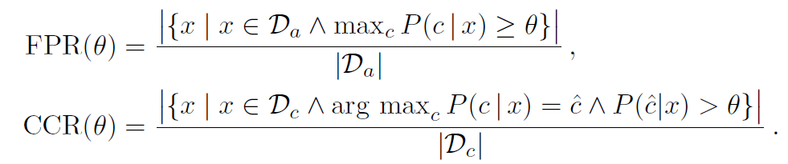
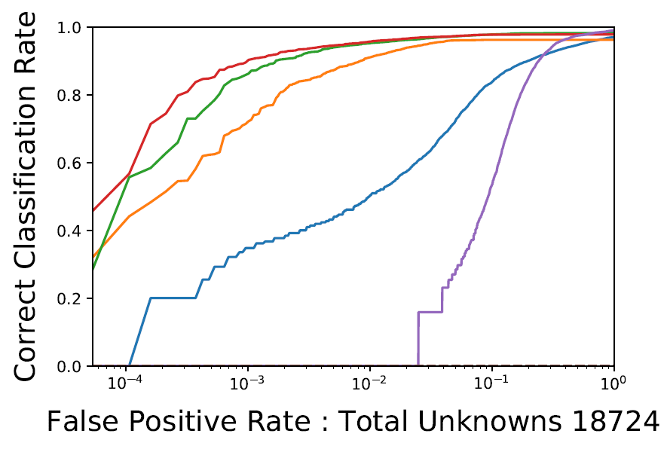
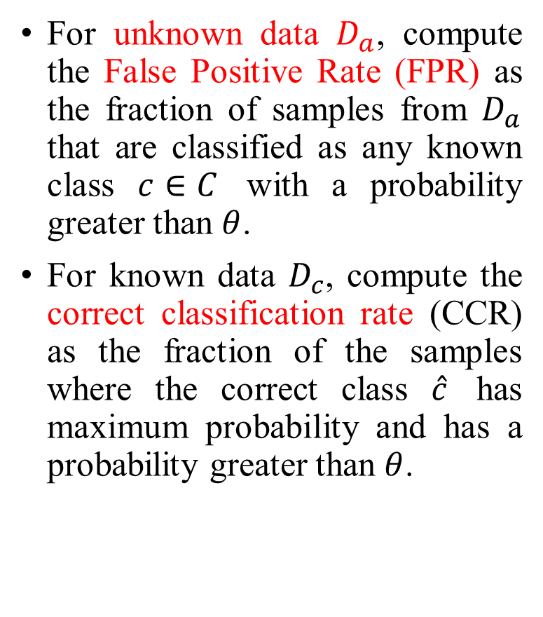
Open-Set Classification Rate (OSCR)
For unknown data $D_{a}$, compute the False Positive Rate (FPR) as the fraction of samples from $D_{a}$ that are classified as any known class $c∈C$ with a probability greater than $θ$.
For known data $D_{c}$, compute the correct classification rate (CCR) as the fraction of the samples where the correct class $\hat{c}$ has maximum probability and has a probability greater than $θ$.
2018 NIPS Reducing Network Agnostophobia

Slide 14
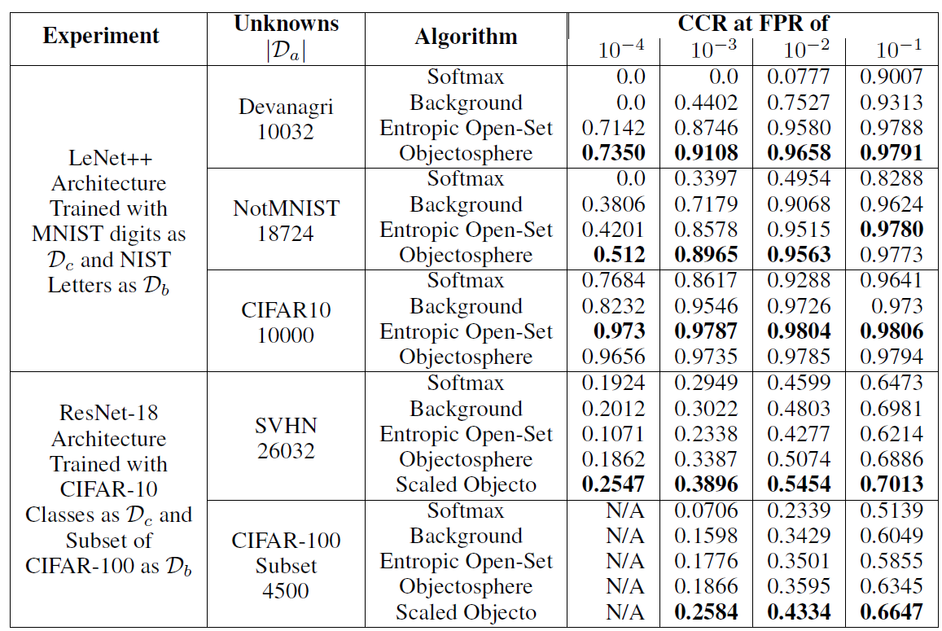
Compare the CCR at FFR of a value. But how about becoming a single value?
Compute the area?
2018 NIPS Reducing Network Agnostophobia

Slide 15
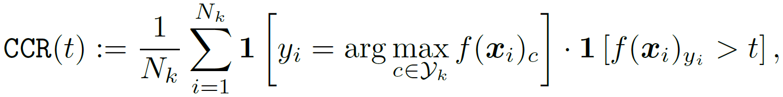
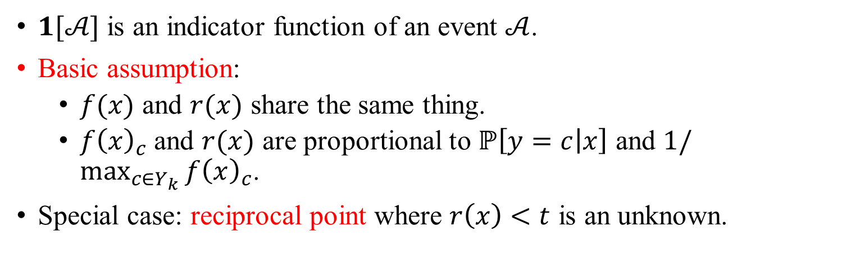
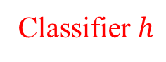

Issue of OSCR
Classifier $h$
Rejecter $R$
$1[𝒜]$ is an indicator function of an event $𝒜$.
Basic assumption:
$f(x)$ and $r(x)$ share the same thing.
$f{\left(x\right)}_{c}$ and $r(x)$ are proportional to $ℙ\left[y=c | x\right]$ and $1/\max_{c∈Y_{k}}{f{\left(x\right)}_{c}}$.
Special case: reciprocal point where $r\left(x\right)<t$ is an unknown.

Slide 16
Quick summary

Slide 17
What can we do to have the desired characteristics?

Slide 18
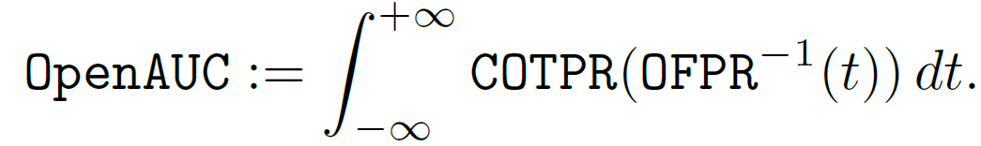
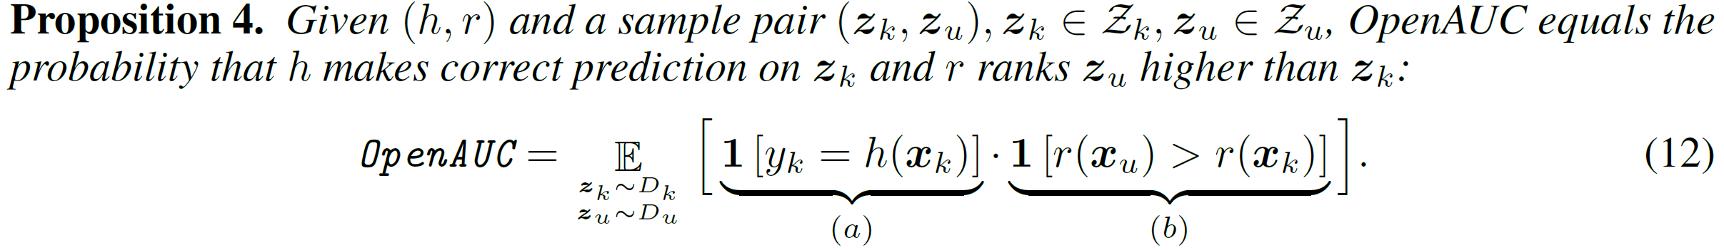
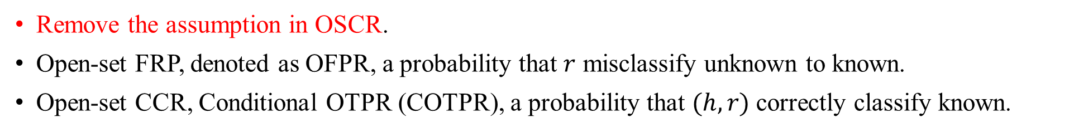
OpenAUC
Remove the assumption in OSCR.
Open-set FRP, denoted as OFPR, a probability that $r$ misclassify unknown to known.
Open-set CCR, Conditional OTPR (COTPR), a probability that $(h,r)$ correctly classify known.

Slide 19
Analyzing the loss equation
(a) (b) → P1: Correct predictions for known with lower open-set scores.
(b) → P2: unknown has a higher open-set score than knowns.

Slide 20
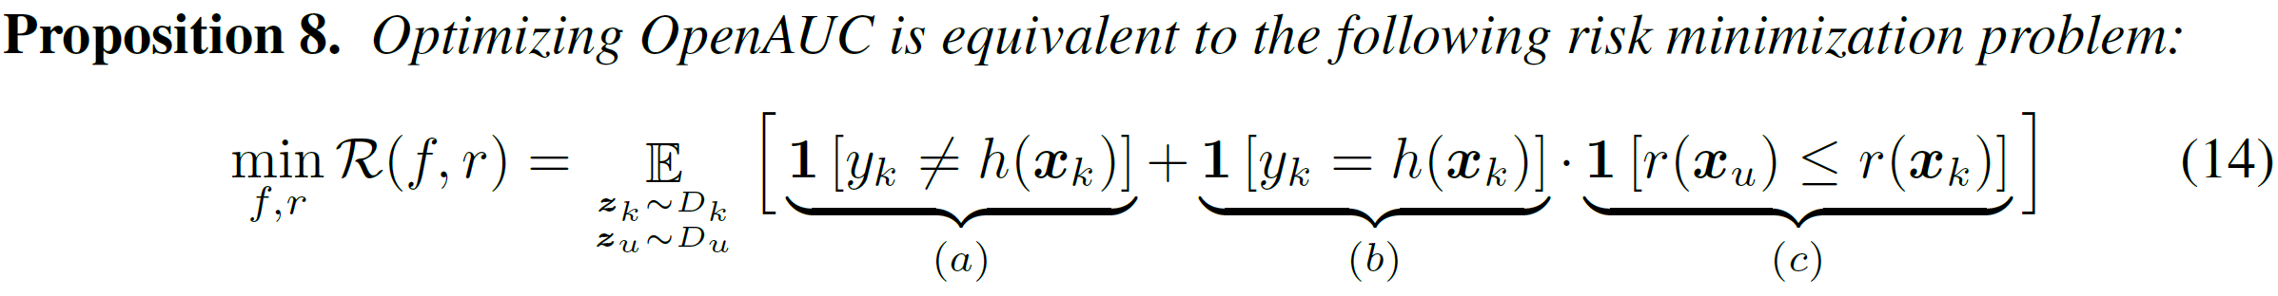

OpenAUC, from metric to loss function
Misclassify known
Reject score of unknown smaller than that of known.
Update in a batch and repeat many times.
How to make unknown images?

Slide 21
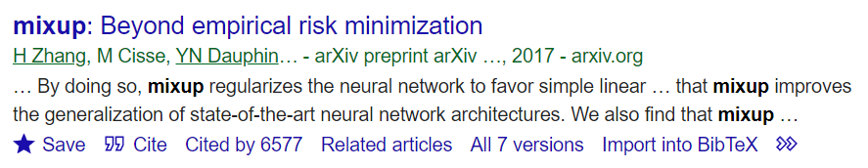
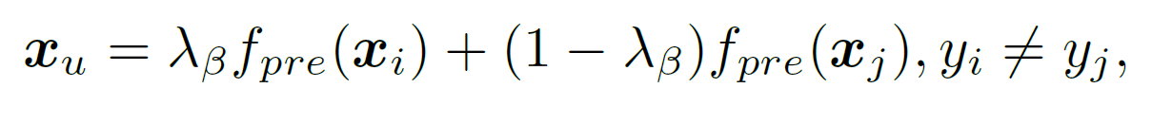
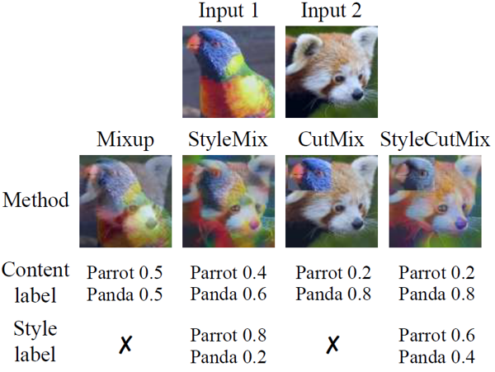
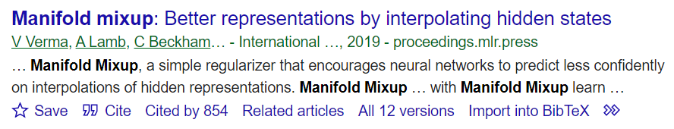
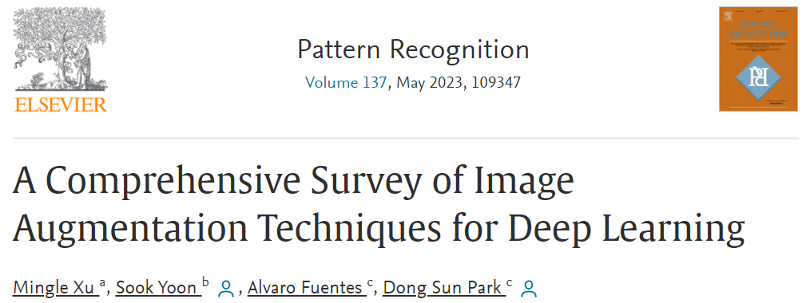

Manifold Mixup to make unknown features
Mixup: linearly combine images and labels
Manifold Mixup: linearly combine image features and labels.
One of the most download papers in the last three months.
We believe that analyzing datasets is essential in practical applications.
Term project recommendation.

Slide 22




Term project thinking
Ablation study using different unknown generation methods in diverse datasets?
Mixup.
Generative adversarial networks.
Heavy block of images and features, or adding noise.
Fusion of two known classes are feature or image level.
We can get our own understanding in this case.
Possible your own papers.
Is OpenAUC effective when the unknown is close to the known? CIFAR10 vs. Weed.

Slide 23

The way to generate unknown images is significant?
A supporting observation from OpenMAX shared by Ibrahim.
Fooling and Openset images are essentially different.
Majority of fooling have lower open-set scores but Openset may have higher open-set scores.
Fooling images are artificially constructed to make a particular class have high activation score via gradient ascending and, hence, to be detected with high confidence.
2016 CVPR Towards open set deep networks

Slide 24
Final OpenAUC loss
One potential issue: the generated unknown may be close to the known when the random variable is small. → hyperparameter $λ.$

Slide 25

Experiment, metric comparison
Metrics with big values but TPR on unknown $↓$, which encourages selecting a threshold that misclassifies more unknown to known.
The performance is sensitive to the thresholds.
Hard to find an optimal threshold.

Slide 26

Experiments, performance comparison of loss function

Slide 27

Fine-grained dataset
CUB: 200 types of birds.
Semantic novelty: easy, medium, and hard.

Slide 28

Experiments in fine-grained dataset
The number of unknown classes and openness.

Slide 29

Experiments, sensitivity analysis of $λ$
(1) OpenAUC is useful to train the model.
(2) $λ=0.1 or 0.2$, get the best performance.
(3) $λ$ $↑$, performance $↓$, maybe because of the noise in the generated unknown features.
Notes:
Quartile

Slide 30
Conclusion
A new metric and potential loss function.
But
The metric is the same as OSCR in most cases.
Unknown images should be given to be a loss function.

Slide 31
Thank You
Questions and comments.
Mingle Xu
xml@jbnu.ac.kr

